Slide 1

MSRA-USTC Project Oral Defense
20
24
Yu Wang
20
24

Slide 2
Table of contents
01
Introduction
04
Experiments
02
Background
05
Analysis
03
Methodology
06
Conclusions
Introduction to prompt engineering and automatic prompt optimization
Experiments on some common NLP datasets(SST-2, Liar)
Related work about automatic prompt optimization, curriculum learning and perplexity
How to incorporate curriculum learning into automatic prompt optimization

Slide 3
01
Introduction
20
24
20
24

Slide 4
Prompt Tuning vs. Prompt Engineering
20
24
Soft Prompt vs. Hard Prompt
Soft Prompt: Learnable tensors
Hard Prompt: Natural Language texts
Prompt Tuning: Optimize soft prompts(Usually used in open-source models)
Prompt Engineering: Optimize hard prompts
20
24
Notes:
概念介绍: 首先介绍soft和hard prompt的区别, 从而引出prompt tuning与prompt engineering的区别

Slide 5
20
24
Automatic Prompt Optimization
Trials and errors, substantial manpower
Traditional Prompt Engineering
Hand-Crafted
Do well in self-reflection and In-Context Learning
Large Language Model
Great general ability
Therefore, automatic prompt optimization has become a new trend/option, which can replace manual efforts
20
24
Notes:
首先引出传统prompt engineering的缺点: 需要手工构建, prompt构建通常是tricky的因为LLM对prompt非常敏感, 因此需要大量的人力
现在的LLM具有很强的通用能力, 有研究表明强大的LLM(如GPT-4)具有self-reflection的能力, 同时LLM也具备In-Context Learning能力
从而automatic prompt optimization成为一种选择和趋势

Slide 6
20
24
Automatic Prompt Optimization
Resample-based
APE(Automatic Prompt Engineer)
APO
OPRO(Optimization by PROmpting)
PromptAgent
PE2(Prompt Engineering a Prompt Engineer)
Current Methods
Reflection-based
20
24
Notes:
现存的automatic prompt optimization的方法: APE、APO、OPRO、PromptAgent、PE2
然后介绍目前的一种分类方式: resample(重新采样), self-reflection对prompt进行反思。当然还有对prompt regenerate/edit的区别, 以及对于meta-prompt的探究

Slide 7
02
Background
20
24
20
24

Slide 8
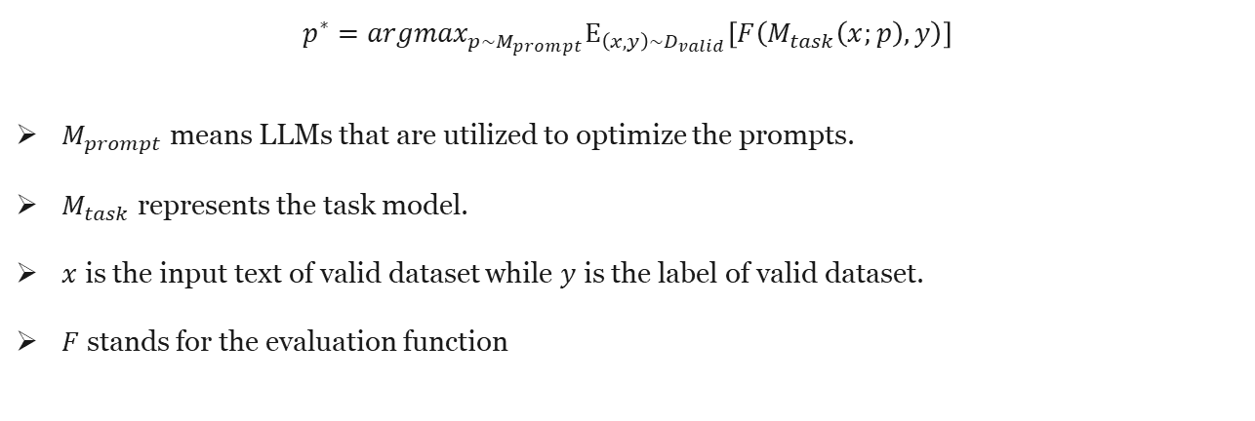
Prompt Engineering
$$p^{∗}={argmax}_{p\sim M_{prompt}}Ε_{\left(x, y\right)\sim D_{valid}}\left[F\left(M_{task}\left(x;p\right),y\right)\right]$$
$M_{prompt}$ means LLMs that are utilized to optimize the prompts.
$M_{task}$ represents the task model.
$x$ is the input text of valid dataset while $y$ is the label of valid dataset.
$F$ stands for the evaluation function
Notes:
介绍Prompt Engineering的formulation, 其中两个M通常为一个LLM, F通常就是acc/F1

Slide 9
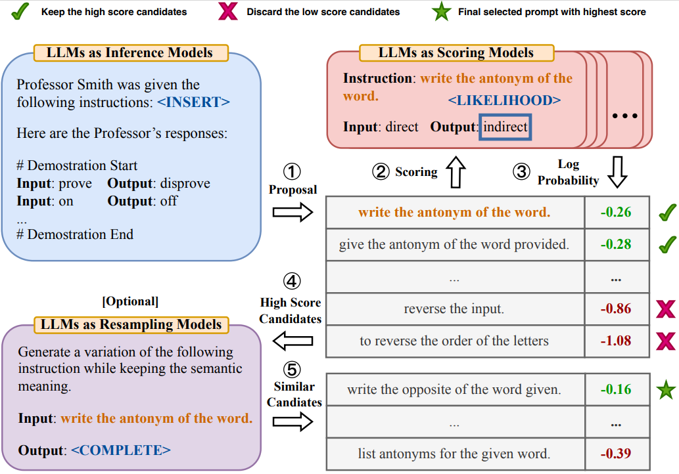
APE
The core idea of APE is to continuously filter and manipulate high-quality prompts.
Generate the variations of prompts based on semantic meaning.
Notes:
APE方法的关键是要不断过滤出分数高的prompt, 然后再对这些prompt进行semantic meaning的扩展。工作流程就是首先挑选一些demonstration, 然后让LLM生成对应的instruction(这里作者探讨了三种生成方式)。之后再在挑选出的评估子集上对prompt利用LLM对prompt进行打分, 选出高分prompt, 按需求根据语义信息进行扩展

Slide 10
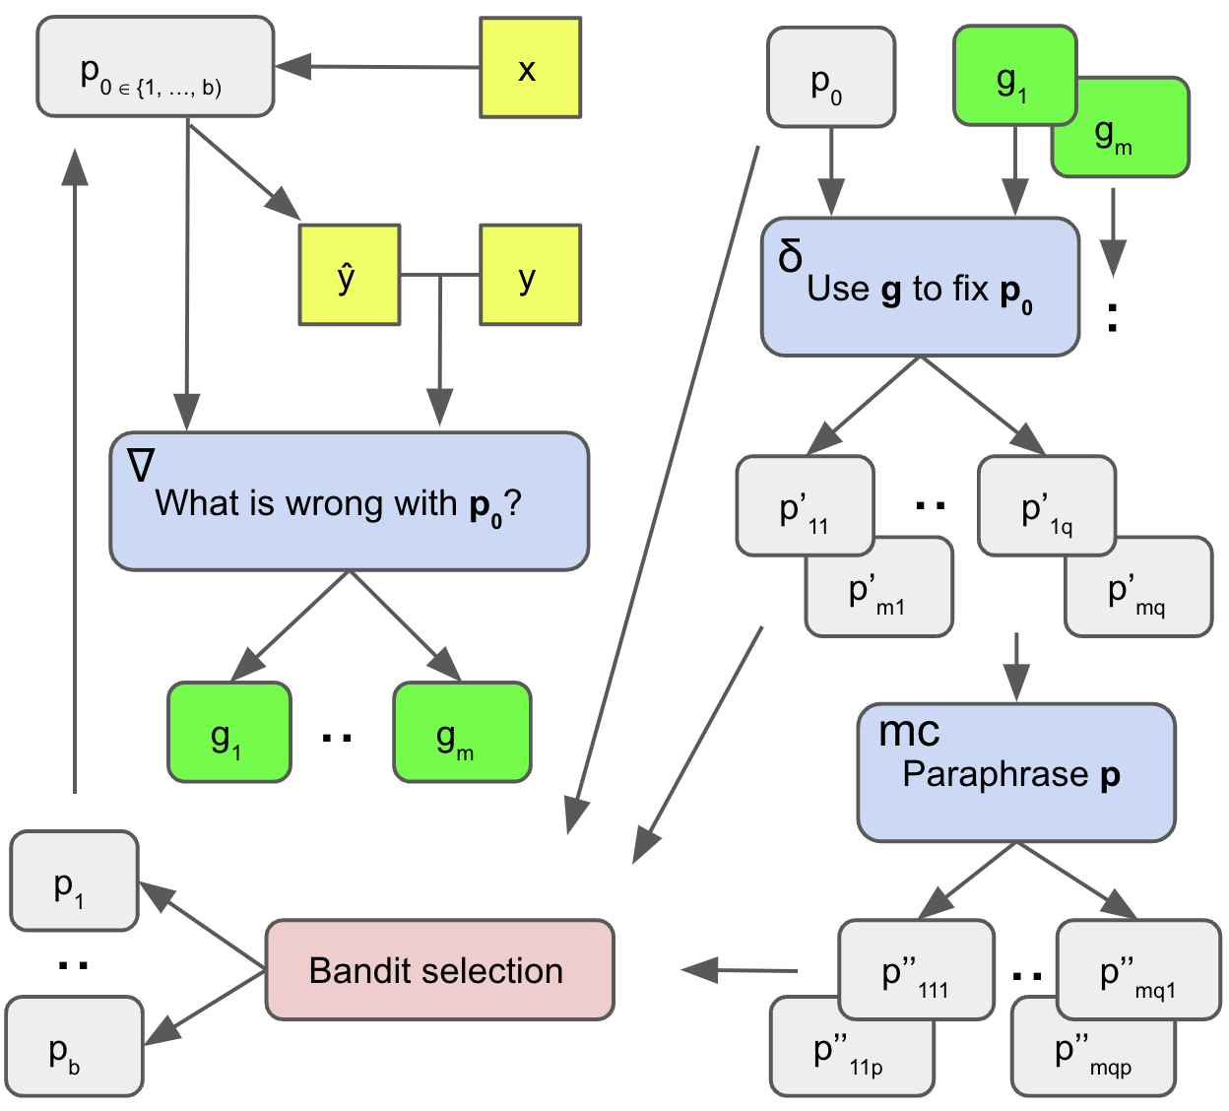
APO
Utilize the self-reflection ability of LLMs to generate the ‘text gradient’ and edit the task prompt(gradient descent process in language space).
Similar to traditional gradient descent process.
Notes:
APO算法是第一个利用LLM的self-reflection能力生成文本gradient的方法。选出minibatch中的errors, 然后根据这些errors来产生feedback(其实就是gradient), 之后根据这些gradient来更新prompt, 做出一些select然后反复迭代

Slide 11
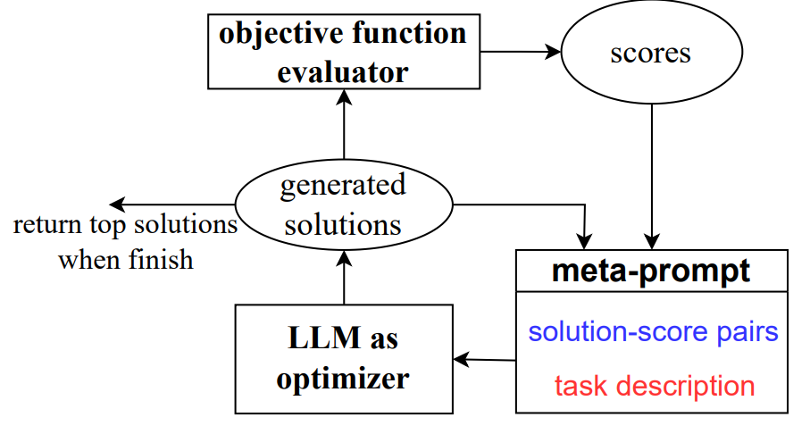
OPRO
OPRO makes use of the full optimization trajectory, which includes past solutions paired with their optimization scores.
Regenerate new prompts through implicit self-reflection
Notes:
让LLM基于过往的迭代记录、优化目标, 自己总结规律, 逐步迭代prompt, 整个过程在文本空间上完成。Meta-prompt包括两个核心部分: solution-score pairs, 即以往的迭代路径按照分数的高低排序; task description, 包含一些任务的examples、优化的目标

Slide 12
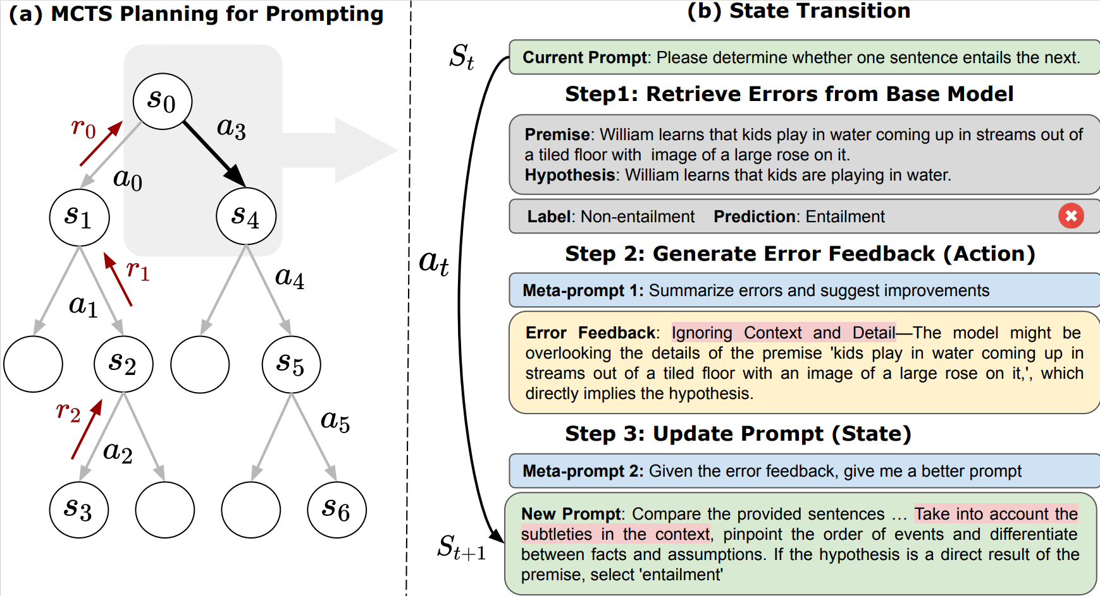
PromptAgent
PromptAgent leverages the self-reflection and planning ability of LLM, formulating the automatic prompt optimization problem as a MDP(Marcov Decision Process)
Notes:
PromptAgent是把问题formulate到MDP问题, state就是prompt, action就是产生feedback, state->new state的过程就是根据feedback产生新的prompt过程

Slide 13
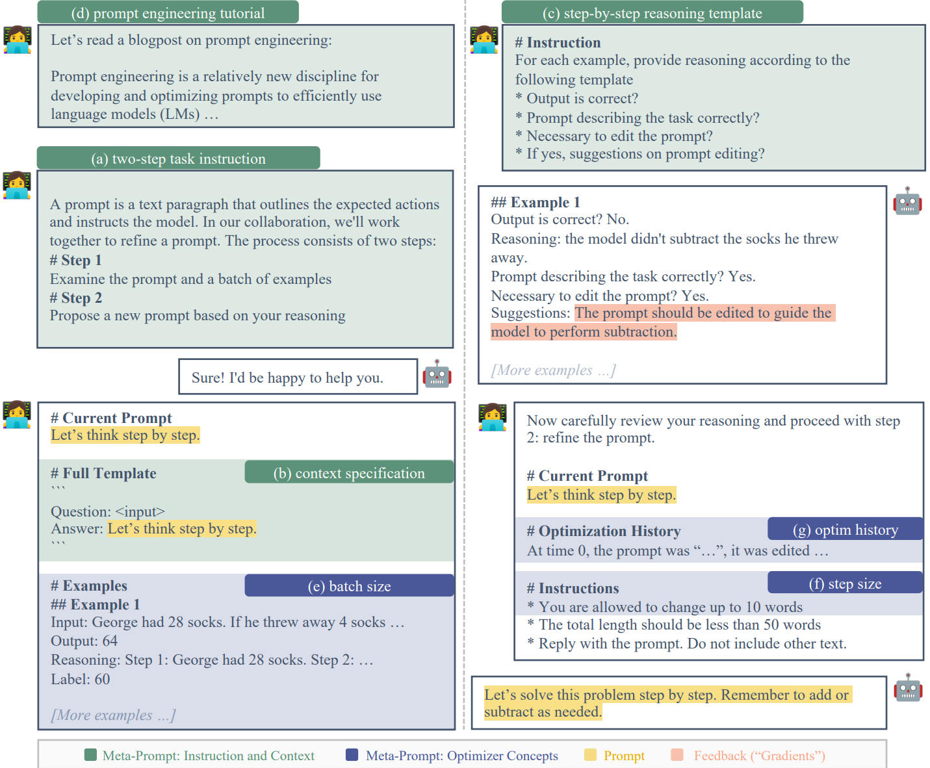
PE2
PE2 focuses on constructing a perfect ‘meta-prompt’ to guide LLM to generate better prompts
two-step task description, context specification, step-by-step reasoning template
Notes:
PE2本质上是对meta-prompt进行操作, 向其中加了一些细节使得LLM产生更好的prompt。相当于在APO上融合了meta-prompt这个东西

Slide 14

Curriculum Learning
Curriculum Learning is a training strategy that mimics the human learning process by training models from easy to difficult tasks.
Curriculum Learning has been demonstrated effective in traditional model training.
Difficulty Measurer + Training Scheduler
Perplexity
$$PPL\left(X\right)=exp⁡\{−\frac{1}{t}\sum_{i}^{t}{\log{p_{θ}(x_{i}|x_{<i})}}\}$$
Notes:
课程学习这种思想是模仿人类学习的过程, 将task从易到难排列让model学习, 它在传统的模型训练中显示了它的有效性。Curriculum Learning要解决的一个问题就是Difficulty Measurer/Training Scheduler的确定。用在APO中就相当于In-Context Learning中的demonstration顺序对结果的影响一样
困惑度是一种评价模型好坏的标准, 直观上理解, 当我们给定一段非常标准的, 高质量的, 符合人类自然语言习惯的文档作为测试集时, 模型生成这段文本的概率越高, 就认为模型的困惑度越小, 模型也就越好。
为什么加perplexity? 因为在原始论文的实现中, 超过最大扩展数时是随机返回一部分prompt的, 因此这里我们把perplexity低的(有个限度)prompt挑出来进入下一个迭代。Perplexity只能当作一种辅助的手段, 因为perplexity过于低的时候会有问题

Slide 15
03
Methodology
20
24
20
24

Slide 16
A flash of Inspiration
Curriculum Learning has been demonstrated effective in traditional model training.
APO framework is similar to traditional model training workflow.
LLM has awesome general ability.
Notes:
这页主要讲的是idea的来源:
Curriculum Learning在传统的模型训练中被证明是有效的
APO框架虽然都是调用model的api, 本质是inference stage, 但是其流程与传统的模型训练类似
当前的模型具有强大的通用能力, 可以满足Curriculum Learning中Difficulty Measurer的要求以及其他的一些要求

Slide 17
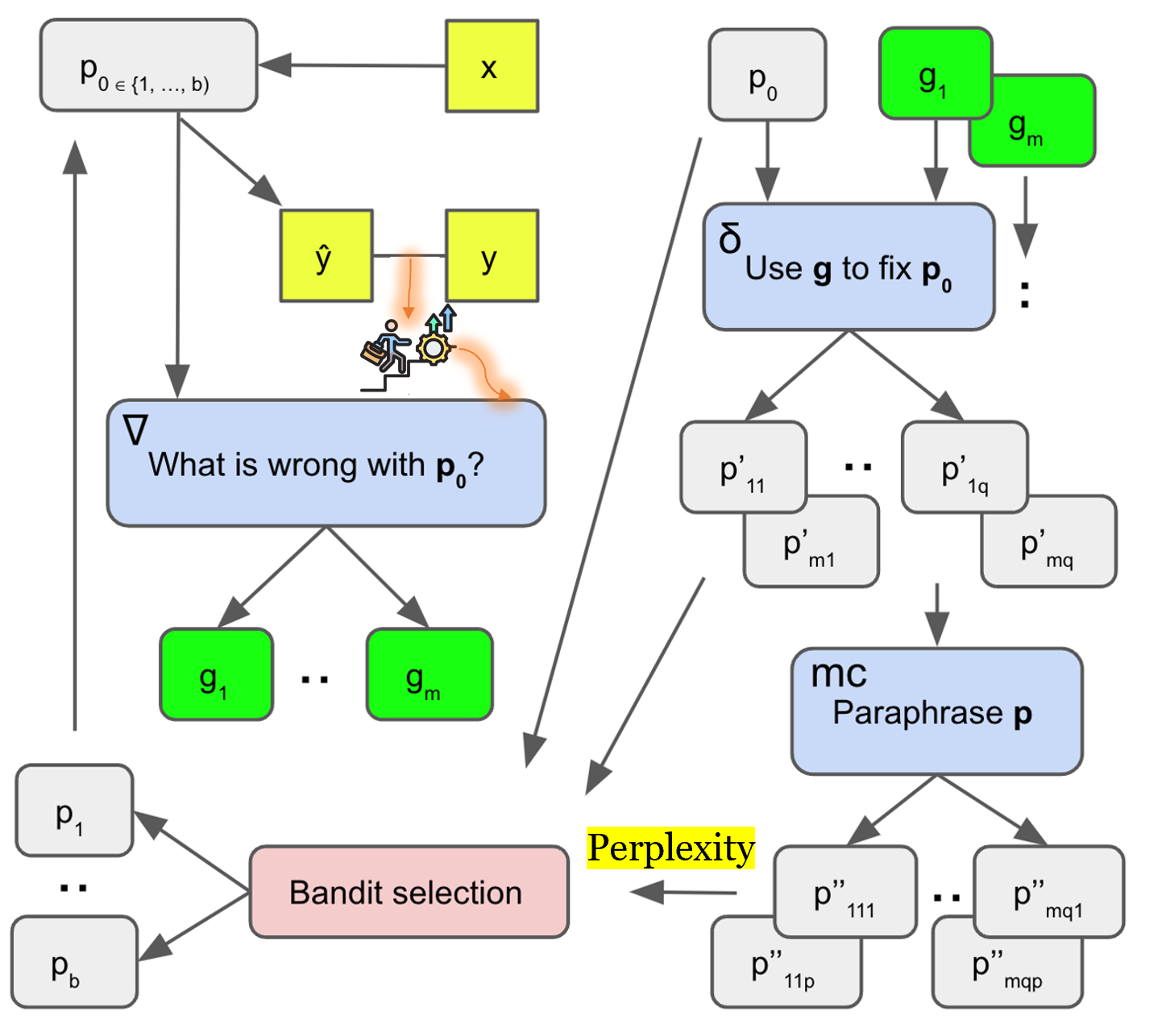
Workflow
Notes:
展示了method的workflow, 主要是两处修改

Slide 18
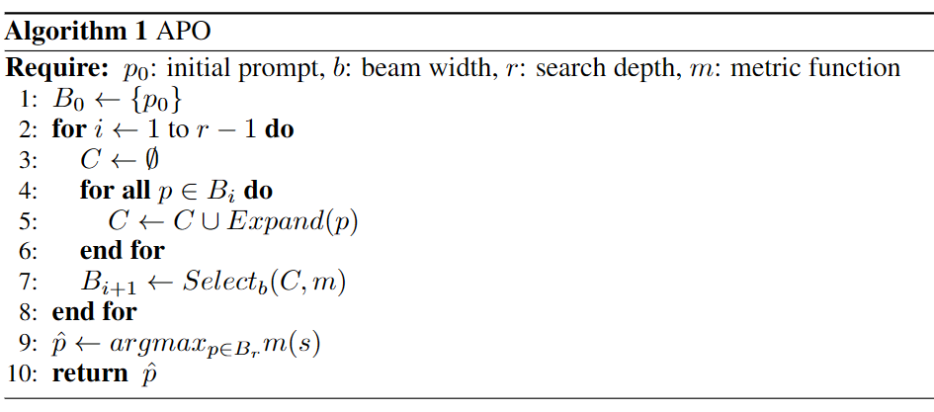
APO Framework
Notes:
Expand函数就是利用self-reflection能力来产生gradient对prompt进行扩展, 然后根据semantic meaning对prompt进行语义扩展
Select函数就是根据某种metric来挑选prompt

Slide 19
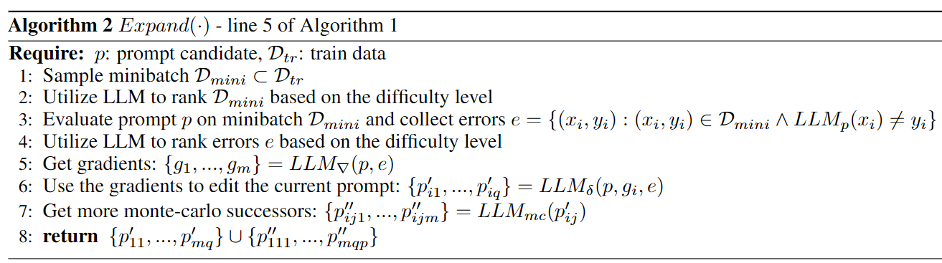
Add Curriculum Learning
Notes:
在第2、4步加入Curriculum Learning, 模拟传统模型训练(传统model training会使得曲线更平滑, 更容易接近global minimum)

Slide 20
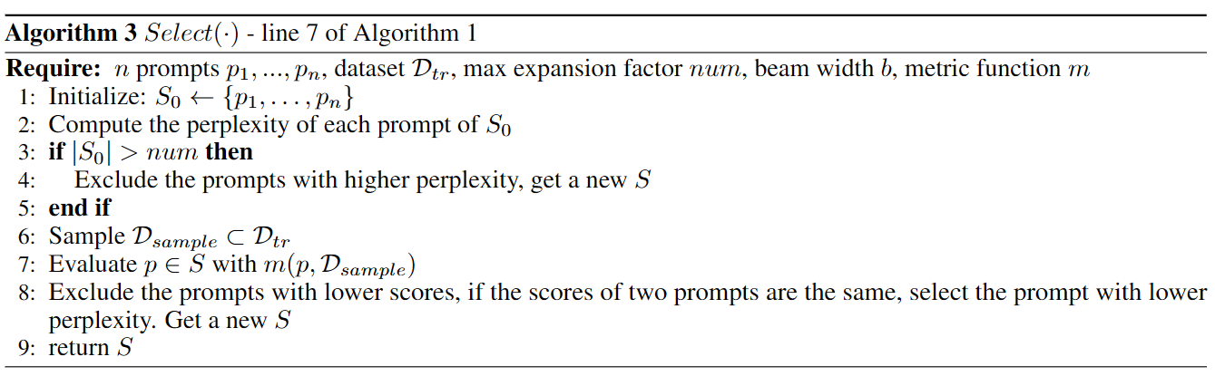
Add Perplexity Metric
Notes:
当扩展的prompt数高于指定数量时, 去除perplexity高的prompt。Beam search选出分数高的prompt。最终的挑选准则是先看F1 score, 然后如果F1相同再看perplexity

Slide 21
04
Experiments
20
24
20
24

Slide 22
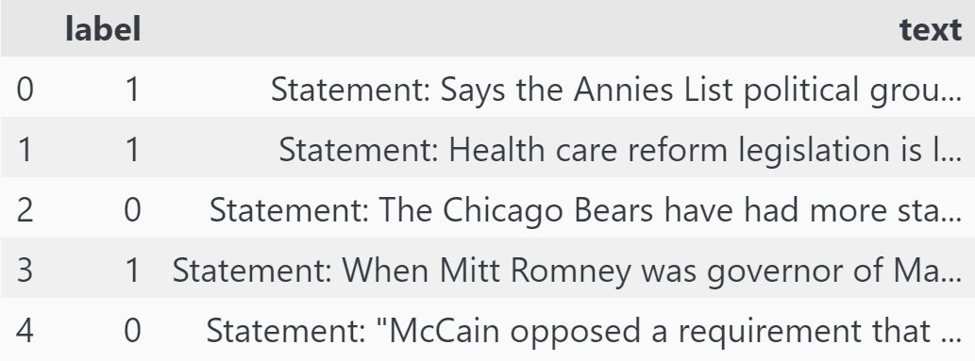
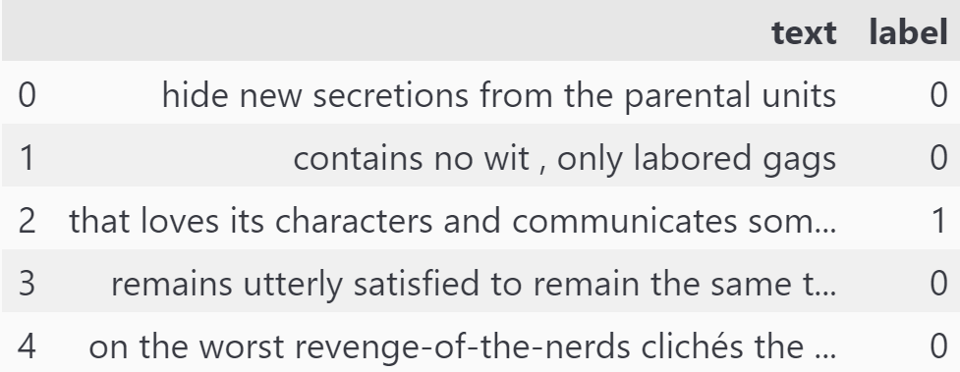
Datasets
Liar dataset: fake news detection
SST-2 dataset: sentiment analysis
Notes:
两个数据集都是简单的二分类问题, 其中Liar数据集是用于检测假新闻, SST-2数据集是用于情感分析

Slide 23
Models(Open-source)
Llama-3-70B-chat-hf: Meta released
Mixtral-8x22B-Instruct-v0.1: Mistral AI released
Qwen1.5-110B-Chat: Alibaba Cloud released
All models are accessed via API calls: together.ai
Notes:
由于我没有购买gpt-4的api, 并且考虑到实验需要的token数也会比较多, 所以使用了有一定免费额度的together.ai中的开源模型。所挑选的三个模型都是在一些evaluation中表现较为突出的模型

Slide 24
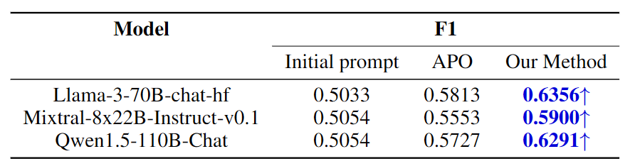
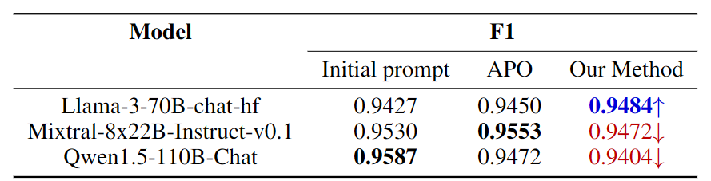
Results
Liar dataset
SST-2 dataset

Slide 25
05
Analysis
20
24
20
24

Slide 26
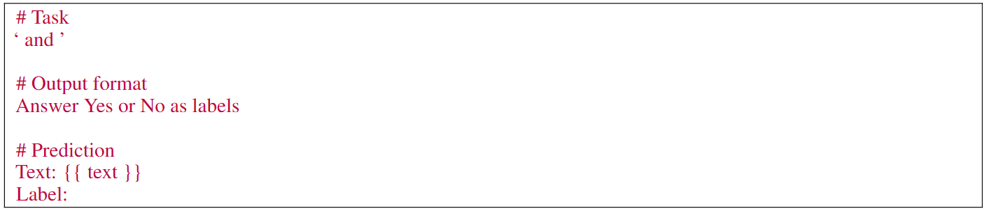
Analysis
the method works when the task is difficult for LLM
LLM is not so sensitive to prompt when the task is easier for LLM
Prompts with lowest perplexity do not always make sense
Notes:
根据实验得到的一些结论:
我们的方法在task对于LLM比较困难的时候是work的
LLM在task不是很难的时候, 对于prompt并不是特别的敏感
Perplexity过低的时候并不make sense(有意义), 因此在实际实验的时候我们采用一个下界来限制住过滤/挑选的prompt

Slide 27
06
Conclusions
20
24
20
24

Slide 28
Conclusions
Through this project, I reviewed numerous papers related to automatic prompt optimization, In-Context Learning and other papers related to LLM.
Figuring out the similarity between APO and traditional model training, I incorporated Curriculum Learning into APO.
During experiments, I noticed that using original metric(F1 score) often resulted in many prompts with identical metrics. Thus I adopted perplexity as an auxiliary metric.
The method works when the task is difficult for LLM.
Notes:
得到的一些结论/总结:
调研了很多有关automatic prompt optimization的工作, In-Context learning的工作, 以及一些与LLM有关的paper
想到APO传统的模型训练过程类似, 因此想用CL来优化APO
实验过程中发现原始的metric在prompt较多时容易产生重复, 所以就想了个新的metric——perplexity
提出的方法对于难的task是有用的

Slide 29
Limitations
Due to network instability, we just ran a few rounds.
Instead of using GPT-4, we chose to utilize the best available open-source models.
The experiments have inherent randomness, and the number of repetitions was insufficient.
Hyperparameters were not meticulously tuned; instead, a single set of hyperparameters was selected for all experiments.
Notes:
网络不稳定, 所以跑的rounds比较少(体现在跑一半就中断, 需要重新跑)
没有使用gpt4, 使用的是目前最好的开源模型
实验具有随机性, 实验重复次数不够多
并没有仔细地调参数，而是挑选了一组超参数给所有实验使用

Slide 30
Thanks!
Any Questions?
terencewang0809@gmail.com
+86 13075579958
20
24

